Slide 1

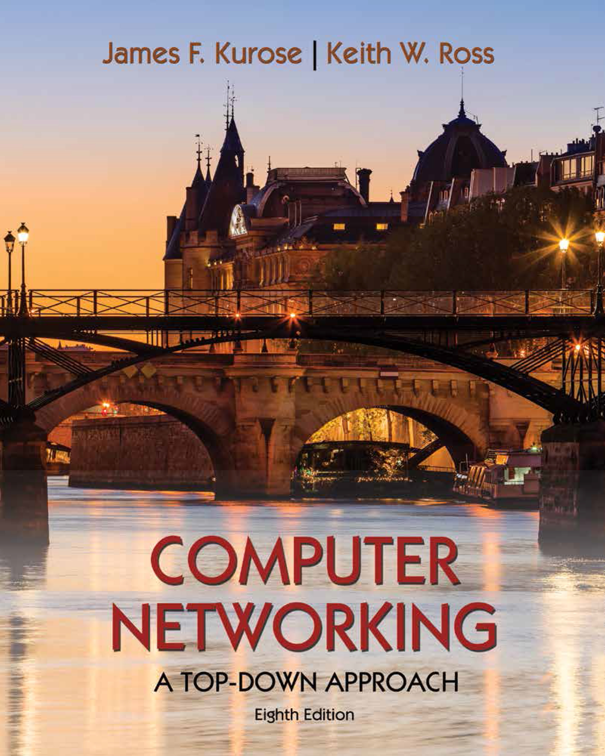
Transport Layer
COMPSCI 453 Computer Networks
Professor Jim Kurose
College of Information and Computer Sciences
University of Massachusetts
Transport-layer services
Multiplexing and demultiplexing
Connectionless transport: UDP
Principles of reliable data transfer
Connection-oriented transport: TCP
Principles of congestion control
TCP congestion control
Evolution of transport-layer functionality
Class textbook:
Computer Networking: A Top-Down Approach (8th ed.)
J.F. Kurose, K.W. Ross
Pearson, 2020
http://gaia.cs.umass.edu/kurose_ross

Slide 2
UDP: User Datagram Protocol
Why is there a UDP?
“no frills,” “bare bones” Internet transport protocol
“best effort” service, UDP segments may be:
lost
delivered out-of-order to app
no connection establishment (which can add RTT delay)
simple: no connection state at sender, receiver
small header size
no congestion control
UDP can blast away as fast as desired!
can function in the face of congestion
connectionless:
no handshaking between UDP sender, receiver
each UDP segment handled independently of others

Slide 3
UDP: User Datagram Protocol
UDP use:
streaming multimedia apps (loss tolerant, rate sensitive)
DNS
SNMP
HTTP/3
if reliable transfer needed over UDP (e.g., HTTP/3):
add needed reliability at application layer
acc congestion control at application layer

Slide 4
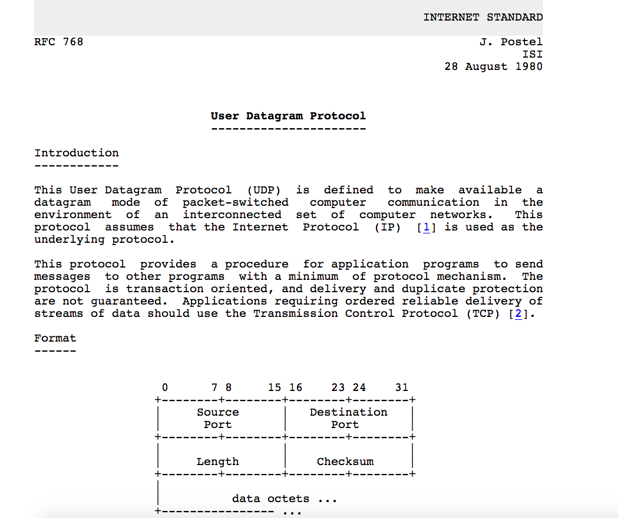
UDP: User Datagram Protocol [RFC 768]
Notes:
read this RFC – it’s only 2.5 pages!

Slide 5
UDP: Transport Layer Actions
SNMP client
SNMP server
application
application
transport
(UDP)
transport
(UDP)
network (IP)
network (IP)
link
link
physical
physical

Slide 6
UDP: Transport Layer Actions
SNMP client
SNMP server
UDP sender actions:
application
application
is passed an application-layer message
SNMP msg
transport
(UDP)
transport
(UDP)
determines UDP segment header fields values
UDP_{h}
SNMP msg
UDP_{h}
creates UDP segment
network (IP)
network (IP)
passes segment to IP
link
link
physical
physical

Slide 7
UDP: Transport Layer Actions
SNMP client
SNMP server
UDP receiver actions:
application
receives segment from IP
application
checks UDP checksum header value
transport
(UDP)
transport
(UDP)
SNMP msg
extracts application-layer message
network (IP)
network (IP)
SNMP msg
UDP_{h}
demultiplexes message up to application via socket
link
link
physical
physical

Slide 8
UDP segment header
32 bits
source port #
dest port #
length
checksum
application
data
(payload)
length, in bytes of UDP segment, including header
data to/from application layer
UDP segment format

Slide 9

UDP checksum
Goal: detect errors (i.e., flipped bits) in transmitted segment
1st number
2nd number
sum
Transmitted: 5 6 11
Received: 4 6 11
receiver-computed
checksum
=
sender-computed
checksum (as received)

Slide 10
UDP checksum
Goal: detect errors (i.e., flipped bits) in transmitted segment
sender:
treat contents of UDP segment (including UDP header fields and IP addresses) as sequence of 16-bit integers
checksum: addition (one’s complement sum) of segment content
checksum value put into UDP checksum field
receiver:
compute checksum of received segment
check if computed checksum equals checksum field value:
Not equal - error detected
Equal - no error detected. But maybe errors nonetheless? More later ….

Slide 11
Internet checksum: an example
example: add two 16-bit integers
1 1 1 0 0 1 1 0 0 1 1 0 0 1 1 0
1 1 0 1 0 1 0 1 0 1 0 1 0 1 0 1
wraparound
1 1 0 1 1 1 0 1 1 1 0 1 1 1 0 1 1
sum
1 0 1 1 1 0 1 1 1 0 1 1 1 1 0 0
checksum
0 1 0 0 0 1 0 0 0 1 0 0 0 0 1 1
Note: when adding numbers, a carryout from the most significant bit needs to be added to the result
* Check out the online interactive exercises for more examples: http://gaia.cs.umass.edu/kurose_ross/interactive/

Slide 12
Internet checksum: weak protection!
example: add two 16-bit integers
0 1
1 1 1 0 0 1 1 0 0 1 1 0 0 1 1 0
1 0
1 1 0 1 0 1 0 1 0 1 0 1 0 1 0 1
wraparound
1 1 0 1 1 1 0 1 1 1 0 1 1 1 0 1 1
Even though numbers have changed (bit flips), no change in checksum!
sum
1 0 1 1 1 0 1 1 1 0 1 1 1 1 0 0
checksum
0 1 0 0 0 1 0 0 0 1 0 0 0 0 1 1

Slide 13
Summary: UDP
“no frills” protocol:
segments may be lost, delivered out of order
best effort service: “send and hope for the best”
UDP has its plusses:
no setup/handshaking needed (no RTT incurred)
can function when network service is compromised
helps with reliability (checksum)
build additional functionality on top of UDP in application layer (e.g., HTTP/3)

Slide 14

Transport Layer
COMPSCI 453 Computer Networks
Professor Jim Kurose
College of Information and Computer Sciences
University of Massachusetts
Transport-layer services
Multiplexing and demultiplexing
Connectionless transport: UDP
Principles of reliable data transfer
Connection-oriented transport: TCP
Principles of congestion control
TCP congestion control
Evolution of transport-layer functionality
Class textbook:
Computer Networking: A Top-Down Approach (8th ed.)
J.F. Kurose, K.W. Ross
Pearson, 2020
http://gaia.cs.umass.edu/kurose_ross
Video: 2020, J.F. Kurose, All Rights Reserved
Powerpoint: 1996-2020, J.F. Kurose, K.W. Ross, All Rights Reserved

Slide 15
Internet checksum: an example
example: add two 16-bit integers
1 1 1 0 0 1 1 0 0 1 1 0 0 1 1 0
1 1 0 1 0 1 0 1 0 1 0 1 0 1 0 1
1 1 0 1 1 1 0 1 1 1 0 1 1 1 0 1 1
* Check out the online interactive exercises for more examples: http://gaia.cs.umass.edu/kurose_ross/interactive/

Slide 16
UDP: User Datagram Protocol
UDP sender/receiver actions
UDP segment format
Internet checksum

